Slide 1

AIRFRAME PROGRESS REPORT
WEEK 3
05-26-2023

Slide 2
OVERVIEW
LAUNCH PAD FABRICATION
FIN DESIGN
PARACHUTE TESTING

Slide 3
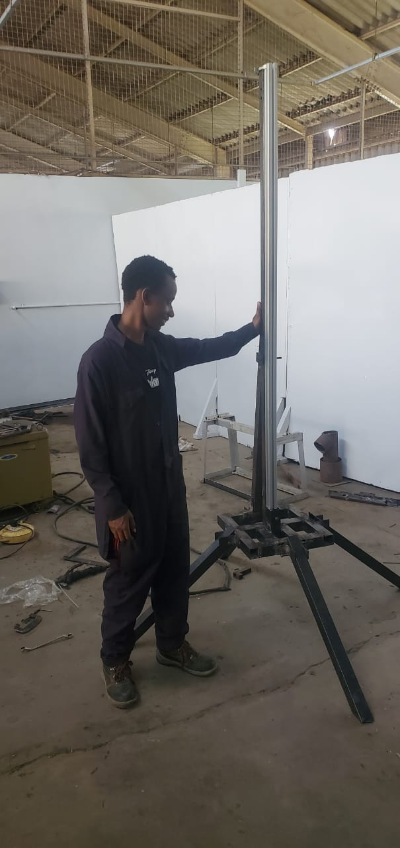
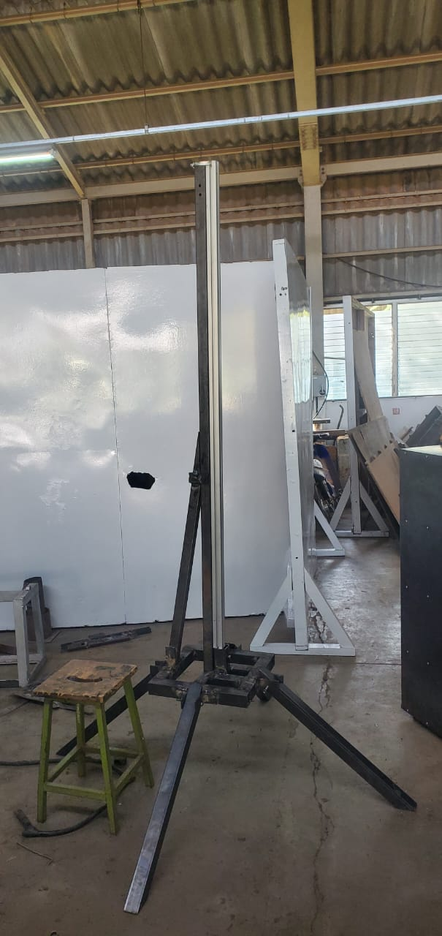
LAUNCH PAD
Complete assembly

Slide 4
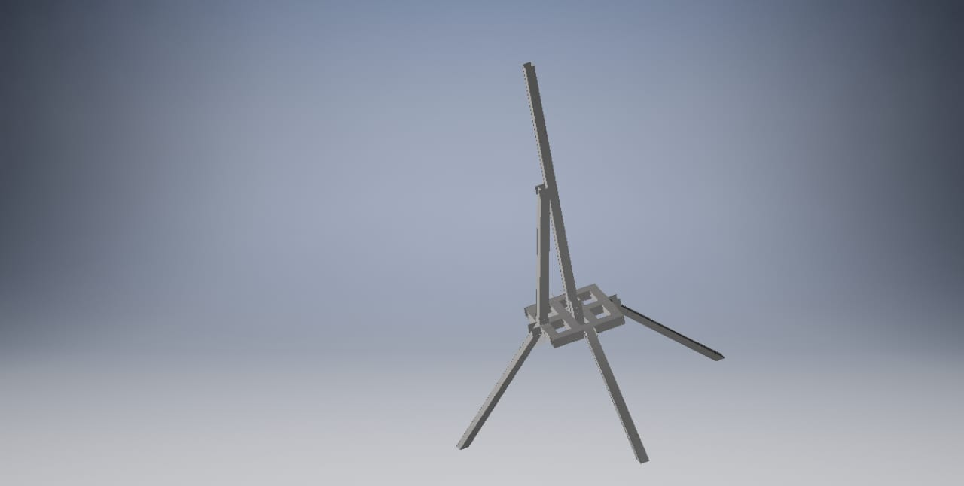
CAD Design
Complete Fabricated design

Slide 5
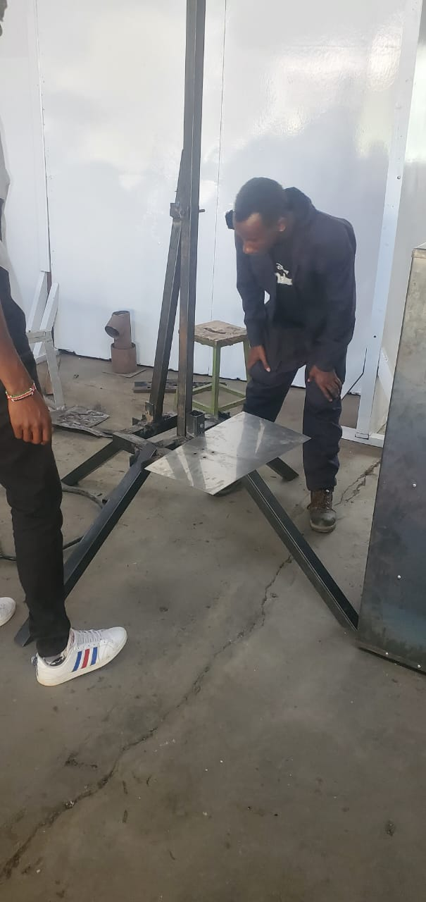
Deflector Plate

Slide 6
Stability & Fin Analysis

Slide 7
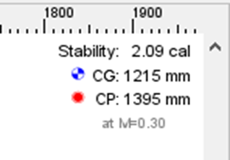
Determining the Center of pressure (CP) and Center of gravity (CG).
Calculating the stability margin.
Stability margin = (𝐶𝑃−𝐶𝑔) / 𝐷 = 2.09302
Theoretical stability Margin value: Target of 2 caliber.
𝑇𝑆𝑀 × 𝐷 = 2 × 86 = 172 mm
Adapted From OpenRocket Software

Slide 8
Fin Sizing and Simulation
Established different parameters and carried out simulations.
Obtained fin parameters:
Number of fins
Root chord
Tip chord
Fin height
Sweep angle
Sweep length
Trapezoidal shape. (Reasons )

Slide 9
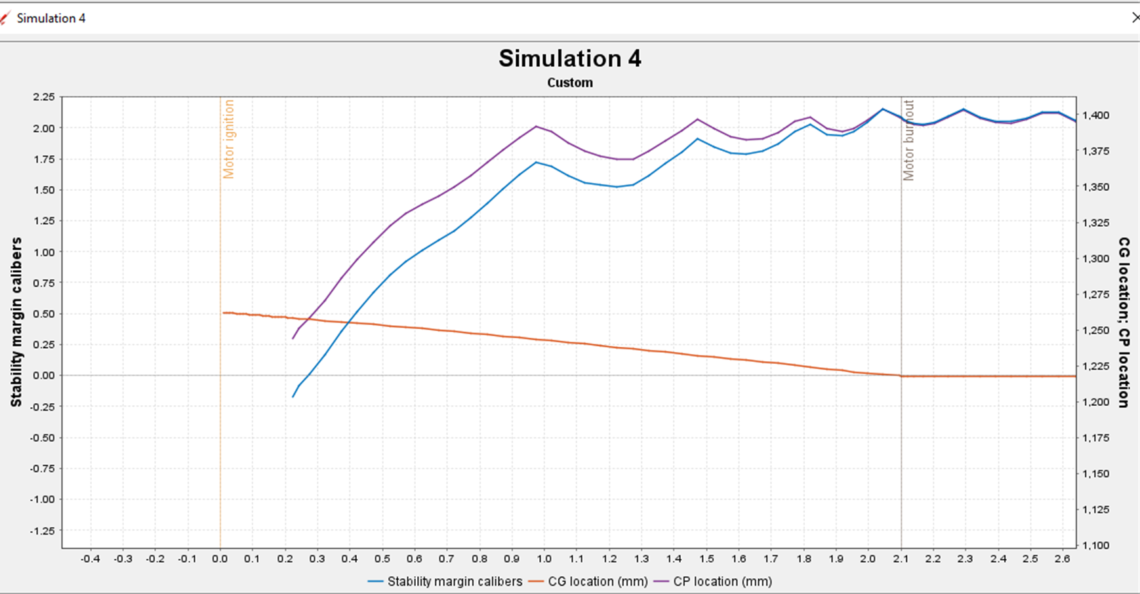
1
2
Plot of Stability against time

Slide 10
Rocket Tests
Motor mount load testing
Fin load tests
Aerodynamic Testing
Stability tests
A Wind tunnel test or Swing test
Drag Measurement (Wind tunnel)
Parachute tests

Slide 11
Motor Mount Testing
Thrust is the force which moves an aircraft through the air, generated by the propulsion system.
Motor mount transfers the thrusting force to the rocket skin/structure.
Estimated Thrust Force for N3 Solid Motor 1200 N (120 kg).
Inadequate gluing of the motor mount can lead to a rocket failure.
Load test value: 2 x Maximum Thrust

Slide 12
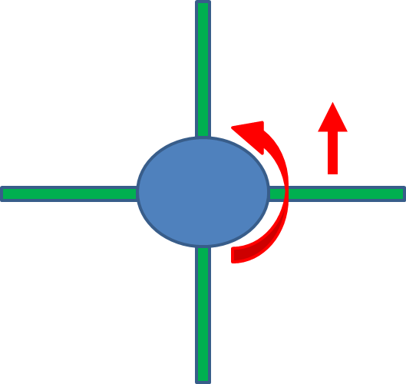
Fin Loading
Fins generate lift and this lift puts a bending load on the fin mounting.
The fins could break off, causing instability due to this load.

Slide 13
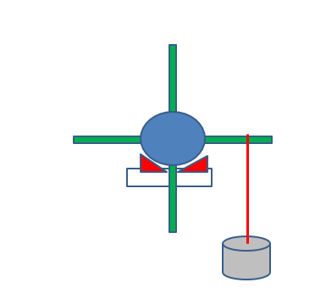
The test weight needs to be 2x the expected maximum aerodynamic bending load.
Applied Test Load

Slide 14
Parachute Testing
Elastic cord adequate to dissipate the opening loads?
Parachute Drift Distance
= Descent time x wind speed

Slide 15
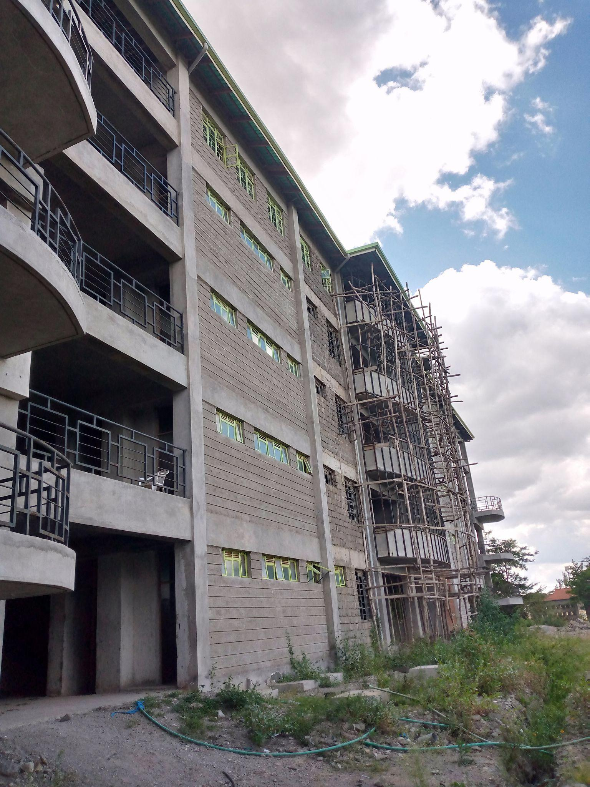
Parachute Drop Test
Launch Point
Landing area
TESTING SIGHT

Slide 16
Drag Coefficient Calculation
2 x Weight
Cd = -----------------------------------------------------------
Air Density x Velocity² x Canopy Area
Weight = Weight hanging from the parachute
Velocity = Average velocity measured from the drop test
Air Density = approximately 1.204 kg/m³, according to the International Standard Atmosphere (ISA)
Canopy Area = Calculate based on the chute design

Slide 17
Next Week’s Objectives
Parachute Drop test
Parachute Simulation using Blender Software
Fin Fabrication and Attachment
Aluminium Rolling

Slide 18

Q/A
THANK YOU!

